Slide 1

https://xkcd.com/936/
Open Source Technology · Digital Privacy · Sustainability

Slide 2

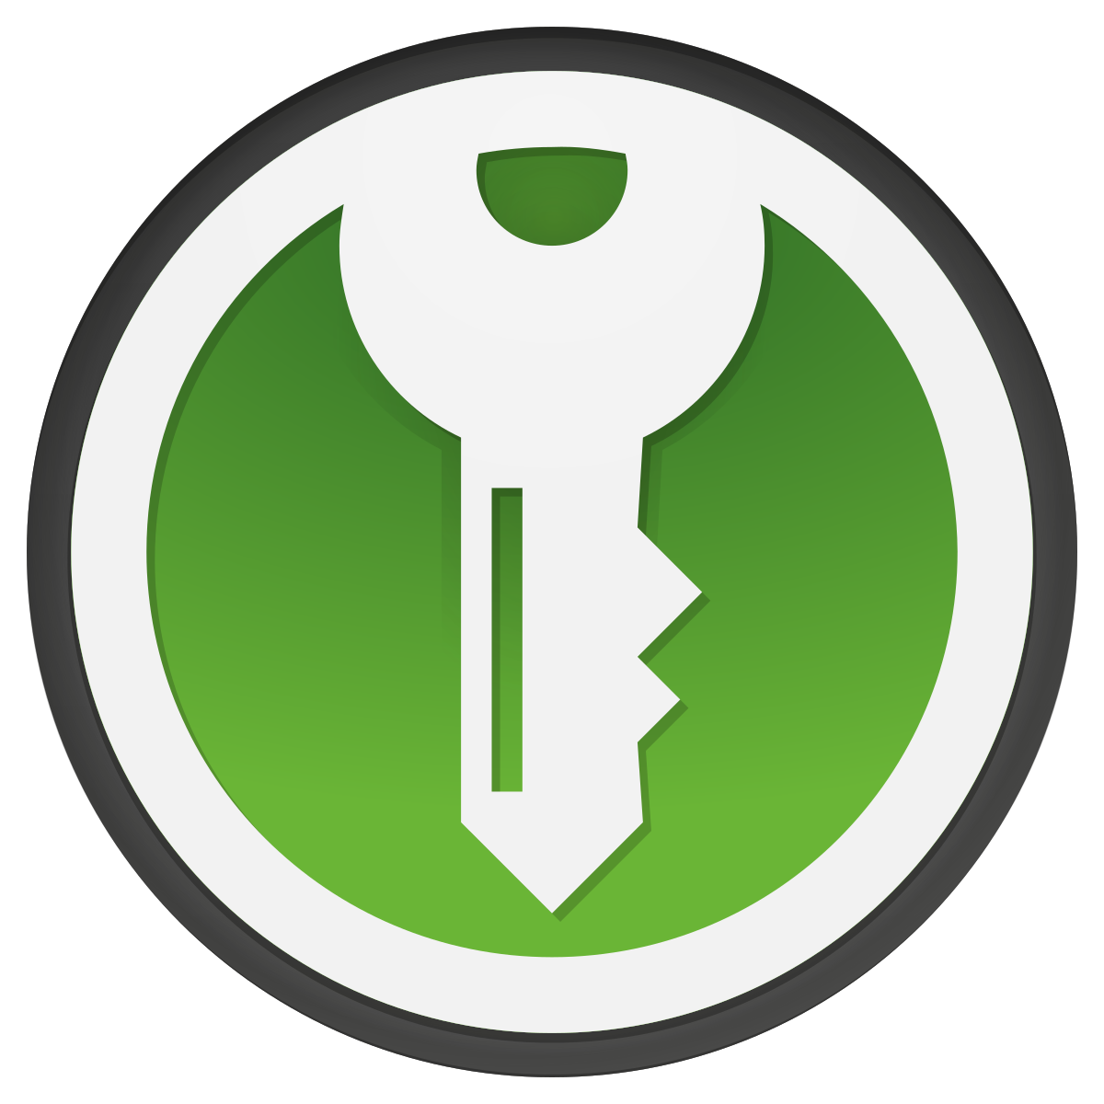
Password Managers, Hardware Keys, and Passkeys

Slide 3
How do I know you are you?
Basic Password Authentication
Your username identifies you. Your password is something you set up with your username that is known only to you and the service, Ohe correct password ensures you are authentic.
How else can I confirm you are you?
You can use multiple factors for authentication…
Something you know: personal identification numbers, passwords, passphrases, DD Form 1833
Something you have: Common Access Card (CAC), hardware token, authentication app on phone, an SMS
Something you are: biometrics (fingerprint, handprint, iris, voice, face)
Somewhere you are: IP address, geolocation, MAC address
Something you do: gestures, patterns of behavior
Key
Tool
Habit/Action
Platform
Key Point
Build your thread model!
Notes:
Open source means that the source code is available to the public and has usually has a permissive license for use. This contrasts with closed source software that has a restrictive license and the source code is not available.
Sources:
https://www.turing.com/blog/open-source-vs-commercial-software-license/#:~:text=Users
%20of%20open%20source%20software,to%20users%20without%20upfront%20costs.
https://www.geeksforgeeks.org/difference-between-open-source-software-and-commercial-software/#

Slide 4
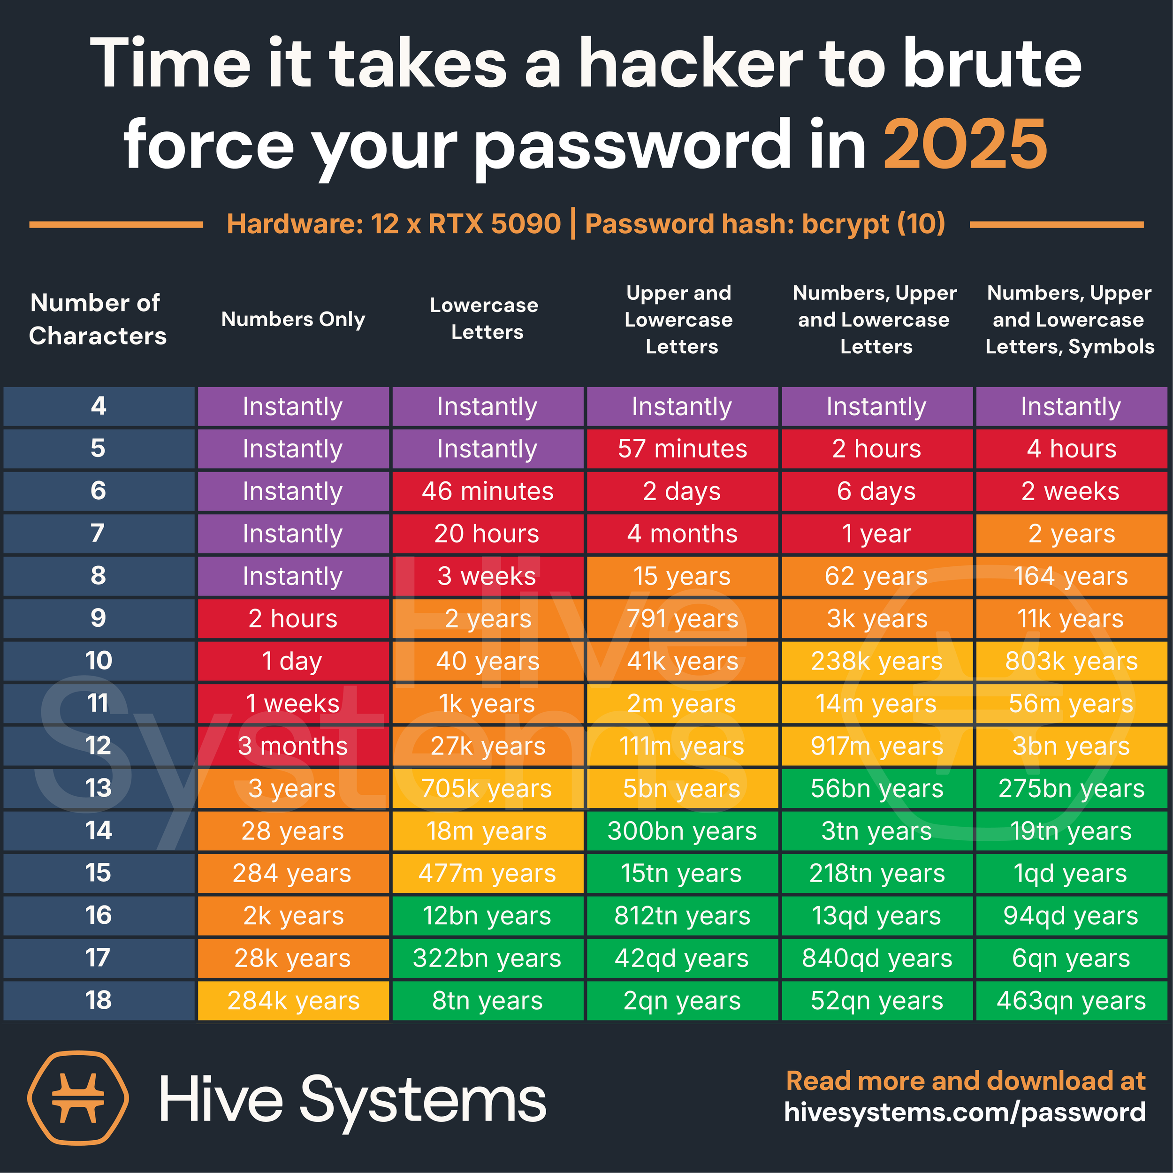
The Problem with Passwords
Your password is probably weak
Passwords are (generally) not stored in plain-text. Instead, they are encrypted by a hash function and stored in a database.
If this hash if found, it can be cracked or compared with a rainbow table.
Passwords that are easy to remember/type are not usually complex
Random passwords are best, but not too practical. And humans are terrible at being random.
Your password has probably been breached
https://haveibeenpwned.com
Shadow-banning and Censorship
Image Source: https://www.hivesystems.com/blog/are-your-passwords-in-the-green
Notes:
Open source means that the source code is available to the public and has usually has a permissive license for use. This contrasts with closed source software that has a restrictive license and the source code is not available.
Sources:
https://www.turing.com/blog/open-source-vs-commercial-software-license/#:~:text=Users
%20of%20open%20source%20software,to%20users%20without%20upfront%20costs.
https://www.geeksforgeeks.org/difference-between-open-source-software-and-commercial-software/#

Slide 5
How can I manage all this?!
The best way to store your passwords is by using a password manager. They allow you to store your passwords in a file or in the cloud and protect them with a single master password. That way, you will only have to remember one strong password, which lets you access the rest of them. (Source.)
Password managers...
generate random passwords of any length, including Diceware passphrases.
securely store them in an encrypted vault (locally or in the cloud).
support autofill and sync
Recommendations
As always, check Privacy Guides first! https://www.privacyguides.org/en/passwords/
Cloud/Hosted
Bitwarden - https://bitwarden.com/
Proton Pass - https://proton.me/pass
1Password - https://1password.com/
Psono - https://psono.com/ (self hostable)
Vaultwarden - https://www.vaultwarden.ca (self hostable)
Local
KeePassXC - https://keepassxc.org/
KeePassDX (Android) - https://keepassdx.com/
KeePassium (iOS & macOS)
- https://keepassium.com/
Notes:
Open source means that the source code is available to the public and has usually has a permissive license for use. This contrasts with closed source software that has a restrictive license and the source code is not available.
Sources:
https://www.turing.com/blog/open-source-vs-commercial-software-license/#:~:text=Users
%20of%20open%20source%20software,to%20users%20without%20upfront%20costs.
https://www.geeksforgeeks.org/difference-between-open-source-software-and-commercial-software/#

Slide 6
Demo
Let’s install KeepassDX

Slide 7
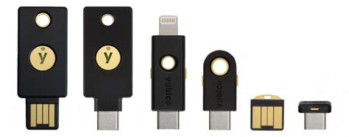
You be what?!
What are Hardware Security Keys?
Hardware security keys can be used to identify and authenticate you into your online accounts. Unlike passwords or biometrics, you’re required to physically possess the key to log in. (Source.)
How does it work?
When registering a hardware security key with an account, the key generates a cryptographic key pair.
The hardware key keeps the private key and the public key is sent and stored by the online service.
When logging in, the service sends a challenge to your hardware key to prove it’s authenticity.
The hardware key cryptographically signs the response which proves the signature could have only come from that key. (Source.)
Recommendations
https://www.privacyguides.org/en/security-keys/
Yubiko Security Key and YubiKey - https://www.yubico.com/
Nitrokey - https://nitrokey.com/
Experimental
You can create your own with open hardware and software! https://www.picokeys.com
Key
Tool
Habit/Action
Platform
Key Point
Build your thread model!
Notes:
Open source means that the source code is available to the public and has usually has a permissive license for use. This contrasts with closed source software that has a restrictive license and the source code is not available.
Sources:
https://www.turing.com/blog/open-source-vs-commercial-software-license/#:~:text=Users
%20of%20open%20source%20software,to%20users%20without%20upfront%20costs.
https://www.geeksforgeeks.org/difference-between-open-source-software-and-commercial-software/#

Slide 8
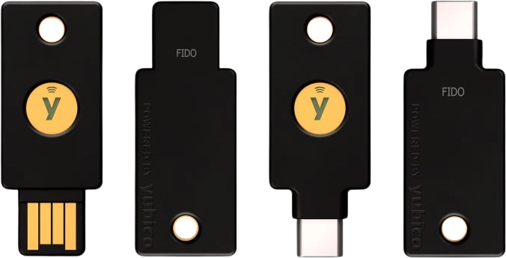
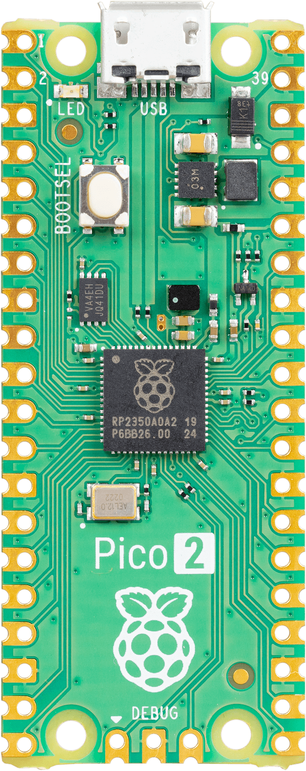
Demo
Let’s try the YubiKey and Pico Key!

Slide 9
So what are passkeys?
What are Passkeys?
Passkeys are like similar to hardware security keys in that you skip the password. However, you can use passkeys with any device like your smartphone or computer. Passkeys also use public key cryptography in combination with another factor.
How does it work?
A passkey provider can be a browser, OS, or credential manager like iCloud keychain or Google password manager. Both cloud-based and local password managers support passkeys as well. You can also store passkeys in your hardware key.
Recommendations
Use one of the recommended third-party password managers from https://www.privacyguides.org/en/passwords/
DEMO
Reference: https://fidoalliance.org/passkeys/
Notes:
Open source means that the source code is available to the public and has usually has a permissive license for use. This contrasts with closed source software that has a restrictive license and the source code is not available.
Sources:
https://www.turing.com/blog/open-source-vs-commercial-software-license/#:~:text=Users
%20of%20open%20source%20software,to%20users%20without%20upfront%20costs.
https://www.geeksforgeeks.org/difference-between-open-source-software-and-commercial-software/#

Slide 10
Fin
Remember: Maintain OPSEC and good digital hygene practices!!!
Thank you for coming!

